Slide 1

`
Pond/Lake Treatment for Algae
An All Natural and Environmentally Friendly Product
Availble through Clean Streams, Rivers and Lakes, Matt Rainoff
at 571-436-6327
© 2023 MinRock Technologies Inc.

Slide 2
MinRock Technologies Inc. is a marketing and development group specializing in Wollastonite and other innovative, environmentally responsible products.
Wollastonite is a high-grade, mined calcium silicate with unique chemical and physical properties that delivers environmental and economic benefits on a wide range of industrial, ecological and agricultural applications.
Our research and development team, working with Clean Streams, Rivers and Lakes have refined our MinRock Pond/Lake Treatment product to give you the best results, as it pertains to each individual pond/lake condition and application requirement.
© 2023 MinRock Technologies Inc.

Slide 3
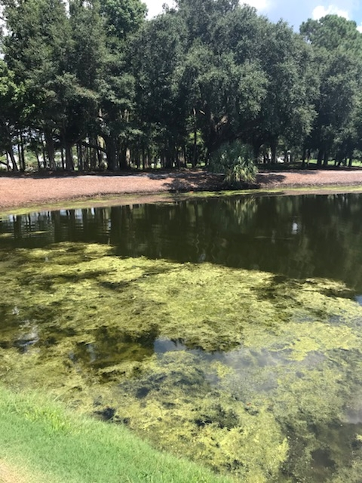
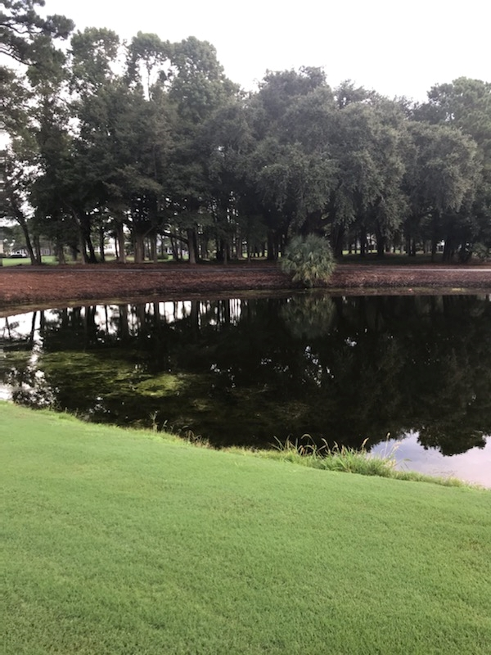
Add a Slide Title - 2
Charleston, SC Area Course Before Treatment
Charleston, SC Area Course
After – 5 Days Later

Slide 4
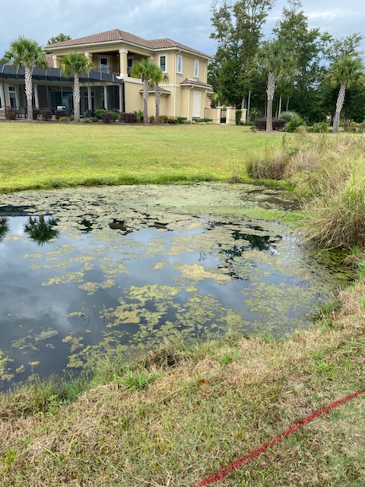
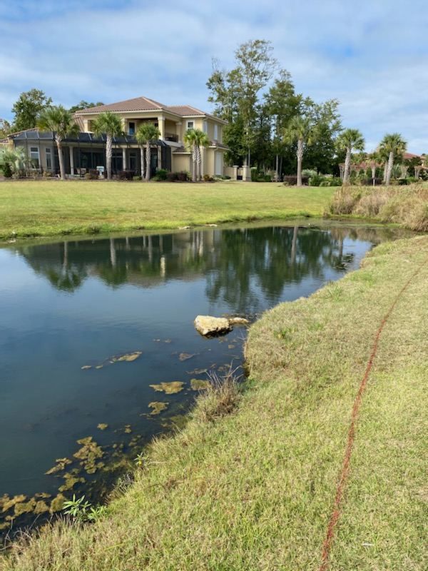
Add a Slide Title - 2
Myrtle Beach, SC Area Course Before Treatment
Myrtle Beach, SC Area Course After – 5 Days Later

Slide 5
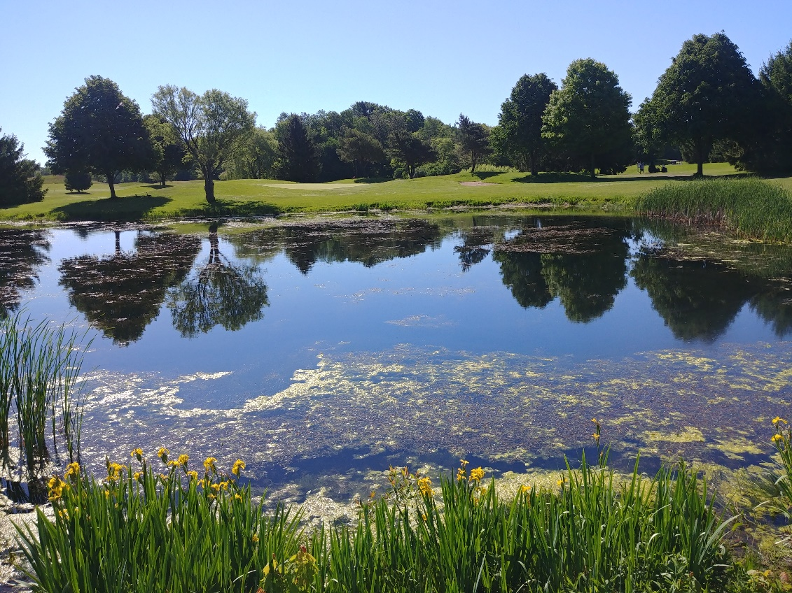
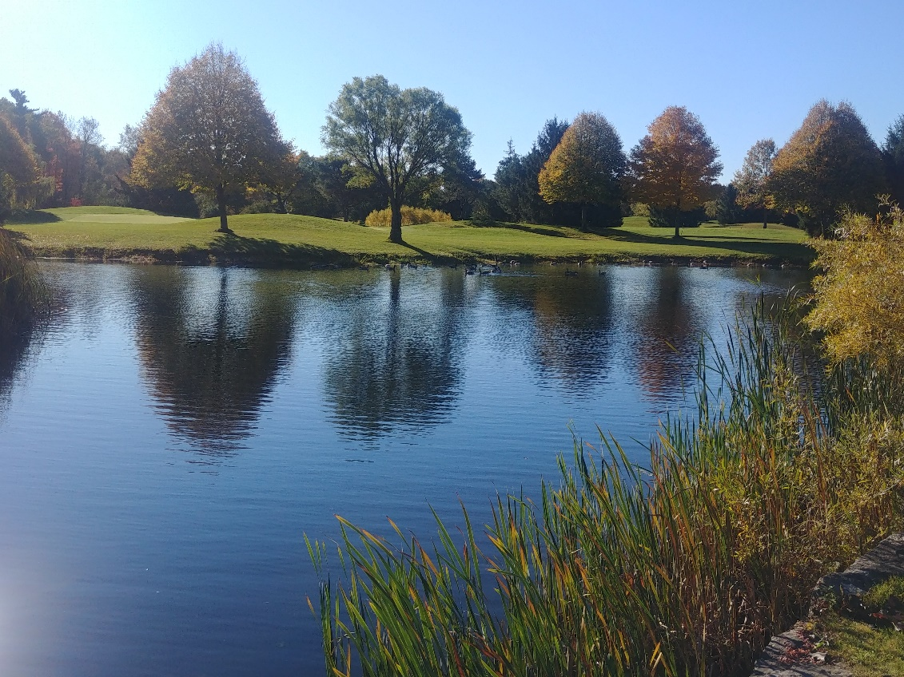
Add a Slide Title - 2
Pine Knot G & CC, Dorchester, ON
Before Treatment
Pine Knot G & CC, Dorchester, ON After - 1 Month Later

Slide 6
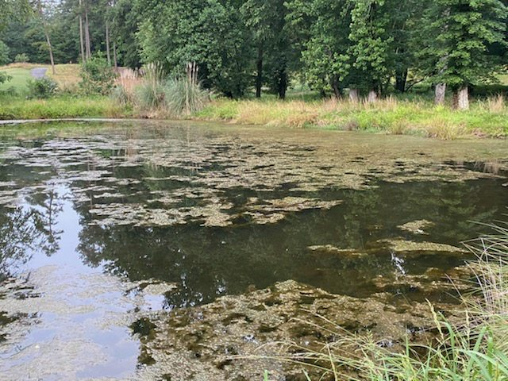
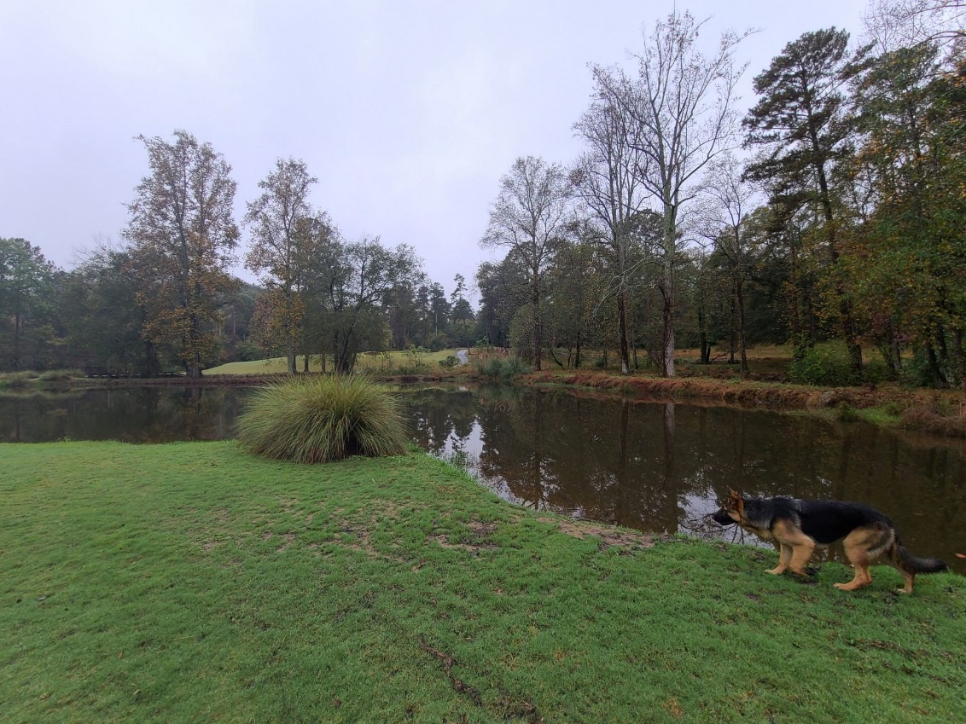
Add a Slide Title - 2
Atlanta, GA Area Course
Before Treatment
Atlanta, GA Area Course
After 5 Months of Treatments

Slide 7
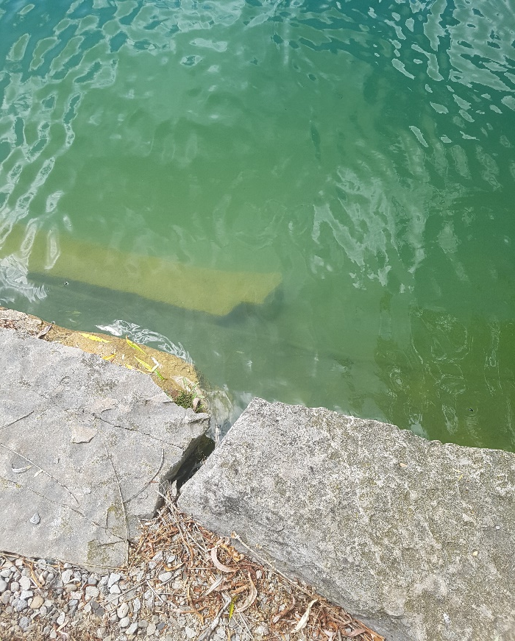
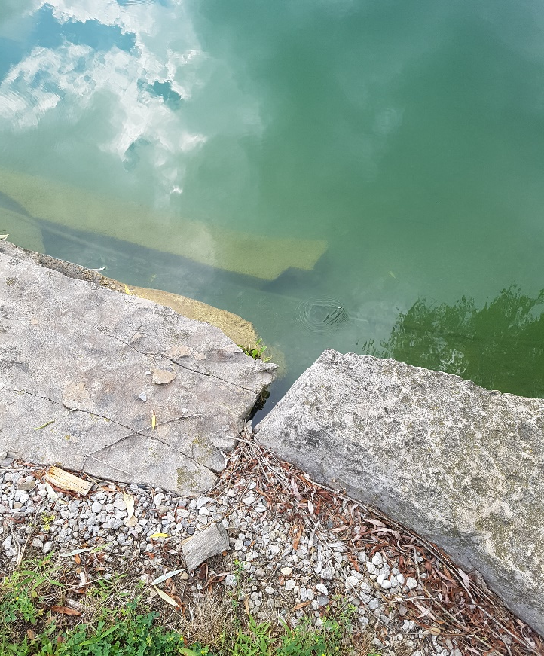
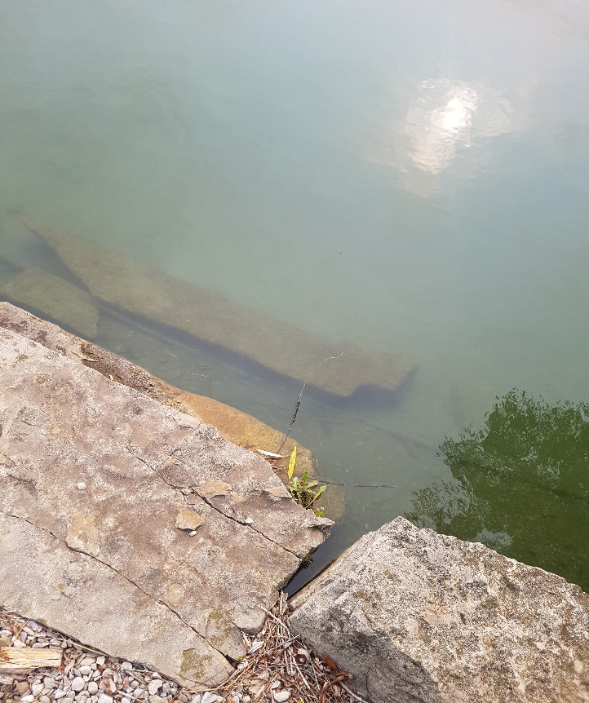
After 2 Treatments After 3 Treatments 1 Month After the 3rd Treatment Stam Family Farm – Near Woodstock, ON – After 3 Treatments
This 2.5 acre pond/lake, used for swimming, contained a Floating Filament Algae that was being treated with chemicals and a dye to help block the sunlight; which aides in deterring phosphate growth.
4 MinRock Pond/Lake Treatments were planned at label application rates, as per the surface area and depth of the pond/lake.
Only 3 applications were needed, over a one month period (July 10th, July 20th and Aug 3rd) , to clear up the Algae and visibility issues in the pond/lake.
© 2023 MinRock Technologies Inc.

Slide 8
Natural and Organically Certified (OMRI) Mined Product; Controls Filamentous and Planktonic Algae growth; Will not harm fish or other aquatic vegetation; Safe to use in irrigation pond/lakes and outdoor garden water features.
© 2023 MinRock Technologies Inc.

Slide 9
Growth of Algae in pond/lakes can be a result of many factors: High nutrient levels in the water; Organic matter accumulating faster than pond/lake bacteria can break it down; Water and Air temperature; Pond/Lake Oxygen levels; The amount of water flowing in and out of the pond/lake.
© 2023 MinRock Technologies Inc.

Slide 10
How does it work? * MinRock Pond/Lake Treatment bonds with excessive pond/lake nutrients making them unavailable, so the Algae are unable to proliferate. By correcting the source of the problem, the pond/lake’s own aerobic bacteria, plus option augmentation of beneficial bacteria will breakdown organic wastes and restore a balanced pond/lake ecosystem. Works great with Aquaritin Diatom Promoter. * Suggested Rates: 25 Lbs. (11.3 Kgs) per Foot Acre. Because of the uniqueness of every pond/lake, rates will vary, so additional treatments may be required.
© 2023 MinRock Technologies Inc.

Slide 11
Why use MinRock Pond/Lake Treatment? Treating Algae chemically or by mechanically removing it from the pond/lake are short term solutions that are expensive and can lead to oxygen depletion and fish kill. MinRock’s Calcium Silicate removes excess phosphorus through mineral sequestration, by forming Calcium Phosphate, a stable and inert mineral. With its food source eliminated, the Algae dies off.
© 2023 MinRock Technologies Inc.

Slide 12
MinRock Technologies Pond/Lake Treatment – Technical Sheet & Sales Tutorial OVERVIEW When it comes to solving Pond/Lake Algae issues, there is a lot of discussion in the industry about “silver bullets” that are aimed at solving the various pond/lake problems with one product. Finding the right solution for each pond/lake dynamic is not an easy task. Because, every pond/lake is different; with different sets of problems and different ecosystems, each property may have different strains of algae to deal with, including some anchored, some free floating throughout the water and some floating on the surface.
© 2023 MinRock Technologies Inc.

Slide 13
ALGAE There are three basic types of pond/lake algae; of which there are thousands of species: Filamentous Algae (Pond/Lake Scum & Moss) This is a single cell plant forming long twines resembling cotton or wool. It grows in shallow areas floating to the surface forming mats. Planktonic Algae These are microscopic free floating cells floating in the top few feet of a pond/lake. They will give a pond/lake a green, green-blue or cloudy brown color. Some brown tint is good as that is Diatom algae which is always present in healthy water. Macro Algae (Chara, Musk grass, Nitella, Stonewarts) This alga grows in the bottom of the pond/lake, anchored to rocks and the pond/lake muck. As it dies it pops up and floats in clumps until completely dead. Then falls as to bottom as sediment. Beneifical Bacteria augmentation will reduce sediment.
© 2023 MinRock Technologies Inc.

Slide 14
POND/LAKE ECOSYSTEMS Algae problems are different than weed problems and must be approached differently. It is critical to keep this in mind, in order to properly align one’s management expectations. The results will vary, depending on the methods utilized and it is difficult to select one best overall practice to achieve the results you expect, because every pond/lake has a Unique Ecosystem. Pond/Lake systems are forever changing, during the seasons, based on water flow, temperature, sunlight, available oxygen levels, to name a few factors. Every pond/lake ecosystem consists of algae, fungi, microorganisms, plants and various fish, which may fall into three distinct classifications: Producers, Consumers and Decomposers.
© 2023 MinRock Technologies Inc.

Slide 15
Producers This category consists of algae, phytoplankton and plants that prepare their own food with the energy emitted from sunlight through photosynthesis. Consumers These consist of herbivores, such as insects, fish and crustaceans and invertebrates that inhabit the pond/lake and consume the plants. Decomposers Decomposers are saprotrophic organisms (bacteria, fungi, microbes) which decompose the dead organic matter back into carbon dioxide and beneficial nutrients for the producers in the pond/lakes ecosystem. In a perfect world, all three categories would stay in balance, giving you a relatively clean pond/lake.
© 2023 MinRock Technologies Inc.

Slide 16
POND/LAKE ECOSYSTEMS All three categories require sufficient oxygen levels for survival, except Diatoms which consume O2 and create CO2 (oxygen). If O2 levels drop or are too low, fish kill will result, plant growth will decline and the Decomposer population will die and possibly change to anaerobic bacteria populations, causing very pungent smelling water. What we are seeing quite often is nutrient enriched water is producing vegetation and algae blooms, quicker than they can be consumed and decomposed. The nitrates and phosphates that enrich the water can come from: Fertilizer runoff into the waterway; Manure runoff; Bird and aquatic life excretions; Excessive organic matter being dumped into the water.
© 2023 MinRock Technologies Inc.

Slide 17
CONTROL There are numerous ways to control Algae: Chemical Control There are currently products on the market such as; Copper Sulphate, Diquat, Reward, Sonar, Floridoine, Shoreline and Rodeo. The use of these products sometimes require special permits as they can be toxic to fish and other aquatic live. They can potentially kill plant life quickly, leaving the dead organic matter to float to the bottom of the pond/lake, leading to addition nutrients building up in the pond/lake and further oxygen depletion leading to fish death. Biological Control with Diatom Blooms Diatoms help consume phosphorus, and carbon dioxide and nitrogen and produce oxygen. Diatoms take the consumed encased nutrients to the pond/lake floor when they die. Not recommended until or unless with the lowering of phosphorus levels using calcium silicate. Physical Control Mechanically harvesting and removing the plants.
© 2023 MinRock Technologies Inc.

Slide 18
Dyes and Colouring of the Pond/Lake This limits the amount of sunlight getting deep into the pond/lake, preventing plant photosynthesis. This does nothing to prevent surface scum algae. Also hurts good algae's from photosynthesis. Aeration, Bubblers and Fountains Adequate dissolved oxygen levels are required to support the beneficial aerobic bacteria; which converts pond/lake organic wastes and ammonia to useable nitrates. If the aerobic bacteria can't keep up, the anaerobic bacteria will take over. These are slower converters leading to higher ammonia levels, nauseous odors and possible fish kill. Growing Diatom blooms will create the needed oxygen even if no mechanical oxygenation is available. Proper Design and Prevention This is by far the best option to prevent algae issues in the first place, but not always easily achieved. Try to keep pond/lake deep with a 3:1 slope so algae cannot get established. Try to prevent phosphates and nitrates from entering the pond/lake with natural buffer zones around the edges. Try to direct polluted waters from entering the pond/lake, if possible. Keep the aerobic bacteria and microbes healthy and limit the amount of organic matter entering the pond/lake.
© 2023 MinRock Technologies Inc.

Slide 19
MINROCK POND/LAKE TREATMENT – LONG TERM SOLUTION Rapid algae growth is caused by excess nutrients in the water (eutrophication) primarily phosphorus and nitrogen. The Calcium Silicate in Algae Pond/Lake Control binds with and sequesters excess phosphorus, rendering inert and creating a stable plant loving mineral Calcium Phosphate. By controlling this nutrition source, algae growth is limited, allowing the aerobic bacteria to break down other organic waste. If at all possible, pond/lakes still require good aeration and proper pH levels. Limiting organic and nutrient seepage into the water will also help control algae growth. Remember, rapid algae kill and bacteria decomposition can cause low water oxygen levels and kill aquatic life.
© 2023 MinRock Technologies Inc.

Slide 20
HIGHLIGHTS (BENEFITS) The product is Natural and Organically Certified (OMRI, EcoCert) in Canada and the USA; It will not harm fish and other aquatic plants, when used as directed; It is safe to use in irrigation pond/lakes. With this basic information, you should be able to understand why pond/lake ecosystems are complex and no two pond/lakes are alike. When using the MinRock Pond/Lake Treatment as part of your overall Pond/Lake health strategy, you are taking a slow, gentle and safe approach to cleaning the pond/lake algae. Repeat applications may be necessary and results do take time. (Take before and after pictures to see how the product is working). Recommended label rates are 25Lbs (11.3 kg) per foot/acre (rate x average pond/lake depth). This rate is could be altered, depending on the individual pond/lake dynamics or the historical data collected, as the pond/lake is treated. Typically, a pond/lake will require weekly repeat applications up to 8 weeks, or until the pond/lake clears up. Watch for the algae blooms to return and repeat the treatments, as required.
© 2023 MinRock Technologies Inc.

Slide 21
REFERENCES Pond Ecosystem (caryinstitute.org) https://secureservercdn.net/198.71.233.184/31m.b34.myftpupload.com/wp-content/uploads/2018/02/36_Phos_Mineral_Adsorption_1999.pdf https://secureservercdn.net/198.71.233.184/31m.b34.myftpupload.com/wp-content/uploads/2018/02/P-reduction-from-Wollastonite-prog99.pdf https://secureservercdn.net/198.71.233.184/31m.b34.myftpupload.com/wp-content/uploads/2018/02/Phosphorus-removal-by-wollastonite-A-constructed-wetland-substrate.pdf https://secureservercdn.net/198.71.233.184/31m.b34.myftpupload.com/wp-content/uploads/2018/02/AN-EVALUATION https://secureservercdn.net/198.71.233.184/31m.b34.myftpupload.com/wp-content/uploads/2018/02/The-Evaluation-Of-Specialized-Permeable-Media-For-Phosphorus-Removal-_-Ph.D..pdf F-FILTER-MEDIA.pdf
© 2023 MinRock Technologies Inc.

Slide 22
 | Pond/Lake Treatment Guidelines for 50 Mesh Product |  |  |  |  |  |  |  |  |  |  |  |  | Rates: 25 Lbs per Foot/Acre
Depth |  |  |  |  |  |  |  |  | Area (in Acres)
Avg. (Ft) | 0.25 | 0.50 | 0.75 | 1.00 | 1.25 | 1.50 | 1.75 | 2.00 | 2.25 | 2.50 | 2.75 | 3.00 | 3.25 | 3.50 | 3.75 | 4.00 | 4.25 | 4.50 | 4.75 | 5.00
1 | 6.25 | 12.5 | 18.8 | 25 | 31.3 | 37.5 | 43.8 | 50 | 56.3 | 62.5 | 68.8 | 75 | 81.3 | 87.5 | 93.8 | 100 | 106 | 113 | 119 | 125
2 | 12.5 | 25 | 37.5 | 50 | 62.5 | 75 | 87.5 | 100 | 113 | 125 | 138 | 150 | 163 | 175 | 188 | 200 | 213 | 225 | 238 | 250
3 | 18.8 | 37.5 | 56.3 | 75 | 93.8 | 113 | 131 | 150 | 169 | 188 | 206 | 225 | 244 | 263 | 281 | 300 | 319 | 338 | 356 | 375
4 | 25 | 50 | 75 | 100 | 125 | 150 | 175 | 200 | 225 | 250 | 275 | 300 | 325 | 350 | 375 | 400 | 425 | 450 | 475 | 500
5 | 31.3 | 62.5 | 93.8 | 125 | 156 | 188 | 219 | 250 | 281 | 313 | 344 | 375 | 406 | 438 | 469 | 500 | 531 | 563 | 594 | 625
6 | 37.5 | 75 | 113 | 150 | 188 | 225 | 263 | 300 | 338 | 375 | 413 | 450 | 488 | 525 | 563 | 600 | 638 | 675 | 713 | 750
7 | 43.8 | 87.5 | 131 | 175 | 219 | 263 | 306 | 350 | 394 | 438 | 481 | 525 | 569 | 613 | 656 | 700 | 744 | 788 | 831 | 875
8 | 50 | 100 | 150 | 200 | 250 | 300 | 350 | 400 | 450 | 500 | 550 | 600 | 650 | 700 | 750 | 800 | 850 | 900 | 950 | 1000
9 | 56.3 | 113 | 169 | 225 | 281 | 338 | 394 | 450 | 506 | 563 | 619 | 675 | 731 | 788 | 844 | 900 | 956 | 1013 | 1069 | 1125
10 | 62.5 | 125 | 188 | 250 | 313 | 375 | 438 | 500 | 563 | 625 | 688 | 750 | 813 | 875 | 938 | 1000 | 1063 | 1125 | 1188 | 1250
*Subject to adjustment, based on individual Pond/Lake Factors (I.e. Algae Type, Ecosystem, Flow, Water Source, Plant & Aquatic Life, Silt, Etc.)

